Slide 1

For information, contact Rusty Lindquist
rusty@LifeEngineering.com | 801-746-9251
Note: This deck includes forward-looking statements. All information herein is proprietary and confidential, copyright Life Engineering Inc., All Rights Reserved

Slide 2
BUSINESS IS HARD
RUNNING A BUSINESS IS HARD!
More variables, more nuance, more complexity than ever before.
PEOPLE
Of all variables, none are more complex or nuanced than
In the middle of the most competitive economic battleground in history, organizations everywhere are fighting over that most precious resource: Workforce Talent.
- Joe Ucuzoglu, CEO, Deloitte
Notes:
WARMER
Running a business today is hard… in fact, it’s probably harder than it’s ever been before. There are simply more variables… more nuance… more complexity then ever before. And of all the variables you have to optimize for, none are more complex or nuanced than people. And we spend a lot of time fighting over and trying to optimize our people. This is a war for talent.

Slide 3
OPTIMIZATION
PEOPLE OPTIMIZATION IS HARD
2020-2021 was known as
2022 was known as the era of
The Great Resignation
Quiet Quitting
More people exiting the workforce than ever before
But the problem isn’t just people who quit and leave…
People who quit and leave…
Turnover
People who quit and STAY…
Disengagement
Notes:
And when it comes to people optimization, we’re in a very difficult time. On top of all the other nuance and political considerations you have to account for, 2020-2021 was known as “The Great Resignation”, with more people exiting the workforce than ever before. That makes it really hard to compete, when there’s such a scarcity of talent.
But then 2022 came along, and with it came a new epidemic, an epidemic of what is now called “Quiet Quitting”.
Whereas the Great Resignation was where people would quit and leave, Quiet Quitting is where they quit and stay. And this can be even worse.
But this is really just a new term on an old idea. Quiet Quitting is simply the way to describe what we’ve been tracking for some time, and that’s employee disengagement.

Slide 4
DISENGAGEMENT
DISENGAGEMENT
PEAK PERFORMANCE (RESULTS)
ACTIONS
WHAT WE DO WITH OUR TIME AND TALENT
EMOTION
THE SENTIMENT WE HAVE FOR THE WORK WE DO
Notes:
Put simply, disengagement is when people lose energy for the work they do.
We use the analogy of an ice berg. We’re trying to get peak performance out of our people, and to do so, we concentrate a lot on time and talent. We do a lot to optimize for these two things, and we measure actions, because these are above the waterline, and easier to observe.
But it’s what’s below the waterline that really matters most, and that’s energy. Energy is what drives up the impact of our time and talent.
When our energy for our work is high, so too is the impact of our time and talent. But when the energy for our work is low, the impact of our time and talent shrinks, and we’re left with a performance gap.
So if we really care about performance, we have to start looking at energy… that’s engagement. And the problem is, because it’s so hard to measure and understand, we tend to ignore it.

Slide 5
DISENGAGEMENT
HOW BIG IS THIS PROBLEM
70%
ALMOST
of workers were not engaged
Gallup Engagement Research
An official occupational phenomenon
World Health Organization
Notes:
And the result of ignoring it, is that it’s now a problem… a huge problem
The latest research from Gallup shows that as much as 70% of the workforce is not engaged.
In fact, it’s now a big enough deal, that the World Health Organization has now called this “an official occupational phenomenon”.

Slide 6
DISENGAGEMENT
HOW BIG IS THIS PROBLEM
34%
20%
A disengaged employee costs an org up to
A disengaged employee only performs at about
of their total performance capacity
of their annual salary
Gallup
15%
37%
Disengaged teams have
A disengaged employee has
Higher Absenteeism
Lower profitability
Gallup
Notes:
And it’s expensive… really expensive…

Slide 7
DISENGAGEMENT
DISENGAGEMENT EVEN IMPACTS
CUSTOMER SATISFACTION
Journal of Occupational and Organizational Psychology
A 3-year study measured the correlation between
EMPLOYEE SENTIMENT = CUSTOMER SENTIMENT
WEAK
STRONG
r = 0.0
r = 0.1
r = 0.2
r = 0.3
r = 0.4
r = 0.5
Smoking & lung cancer : r = . 08
Correlation Coefficient Comparisons
American Psychologist
Effect of ibuprofen on pain reduction: r = . 14
Employee engagement and customer satisfaction: r = . 43
Notes:
In fact, the impact doesn’t just stop with performance and cost… it impacts customers.
There was this longitudinal study to measure the correlation between employee sentiment and customer sentiment, and what they found was that is was more strongly correlated than even smoking to lung cancer… or how effective Ibuprofen is on pain reduction.
In other words, you can expect that however your employees feel, is likely going to be an accurate representation about how your customers feel.
That can be bad… but it can be good. It means that if you improve employee satisfaction and engagement, you not only get higher performance, but also improved customer and market outcomes.

Slide 8
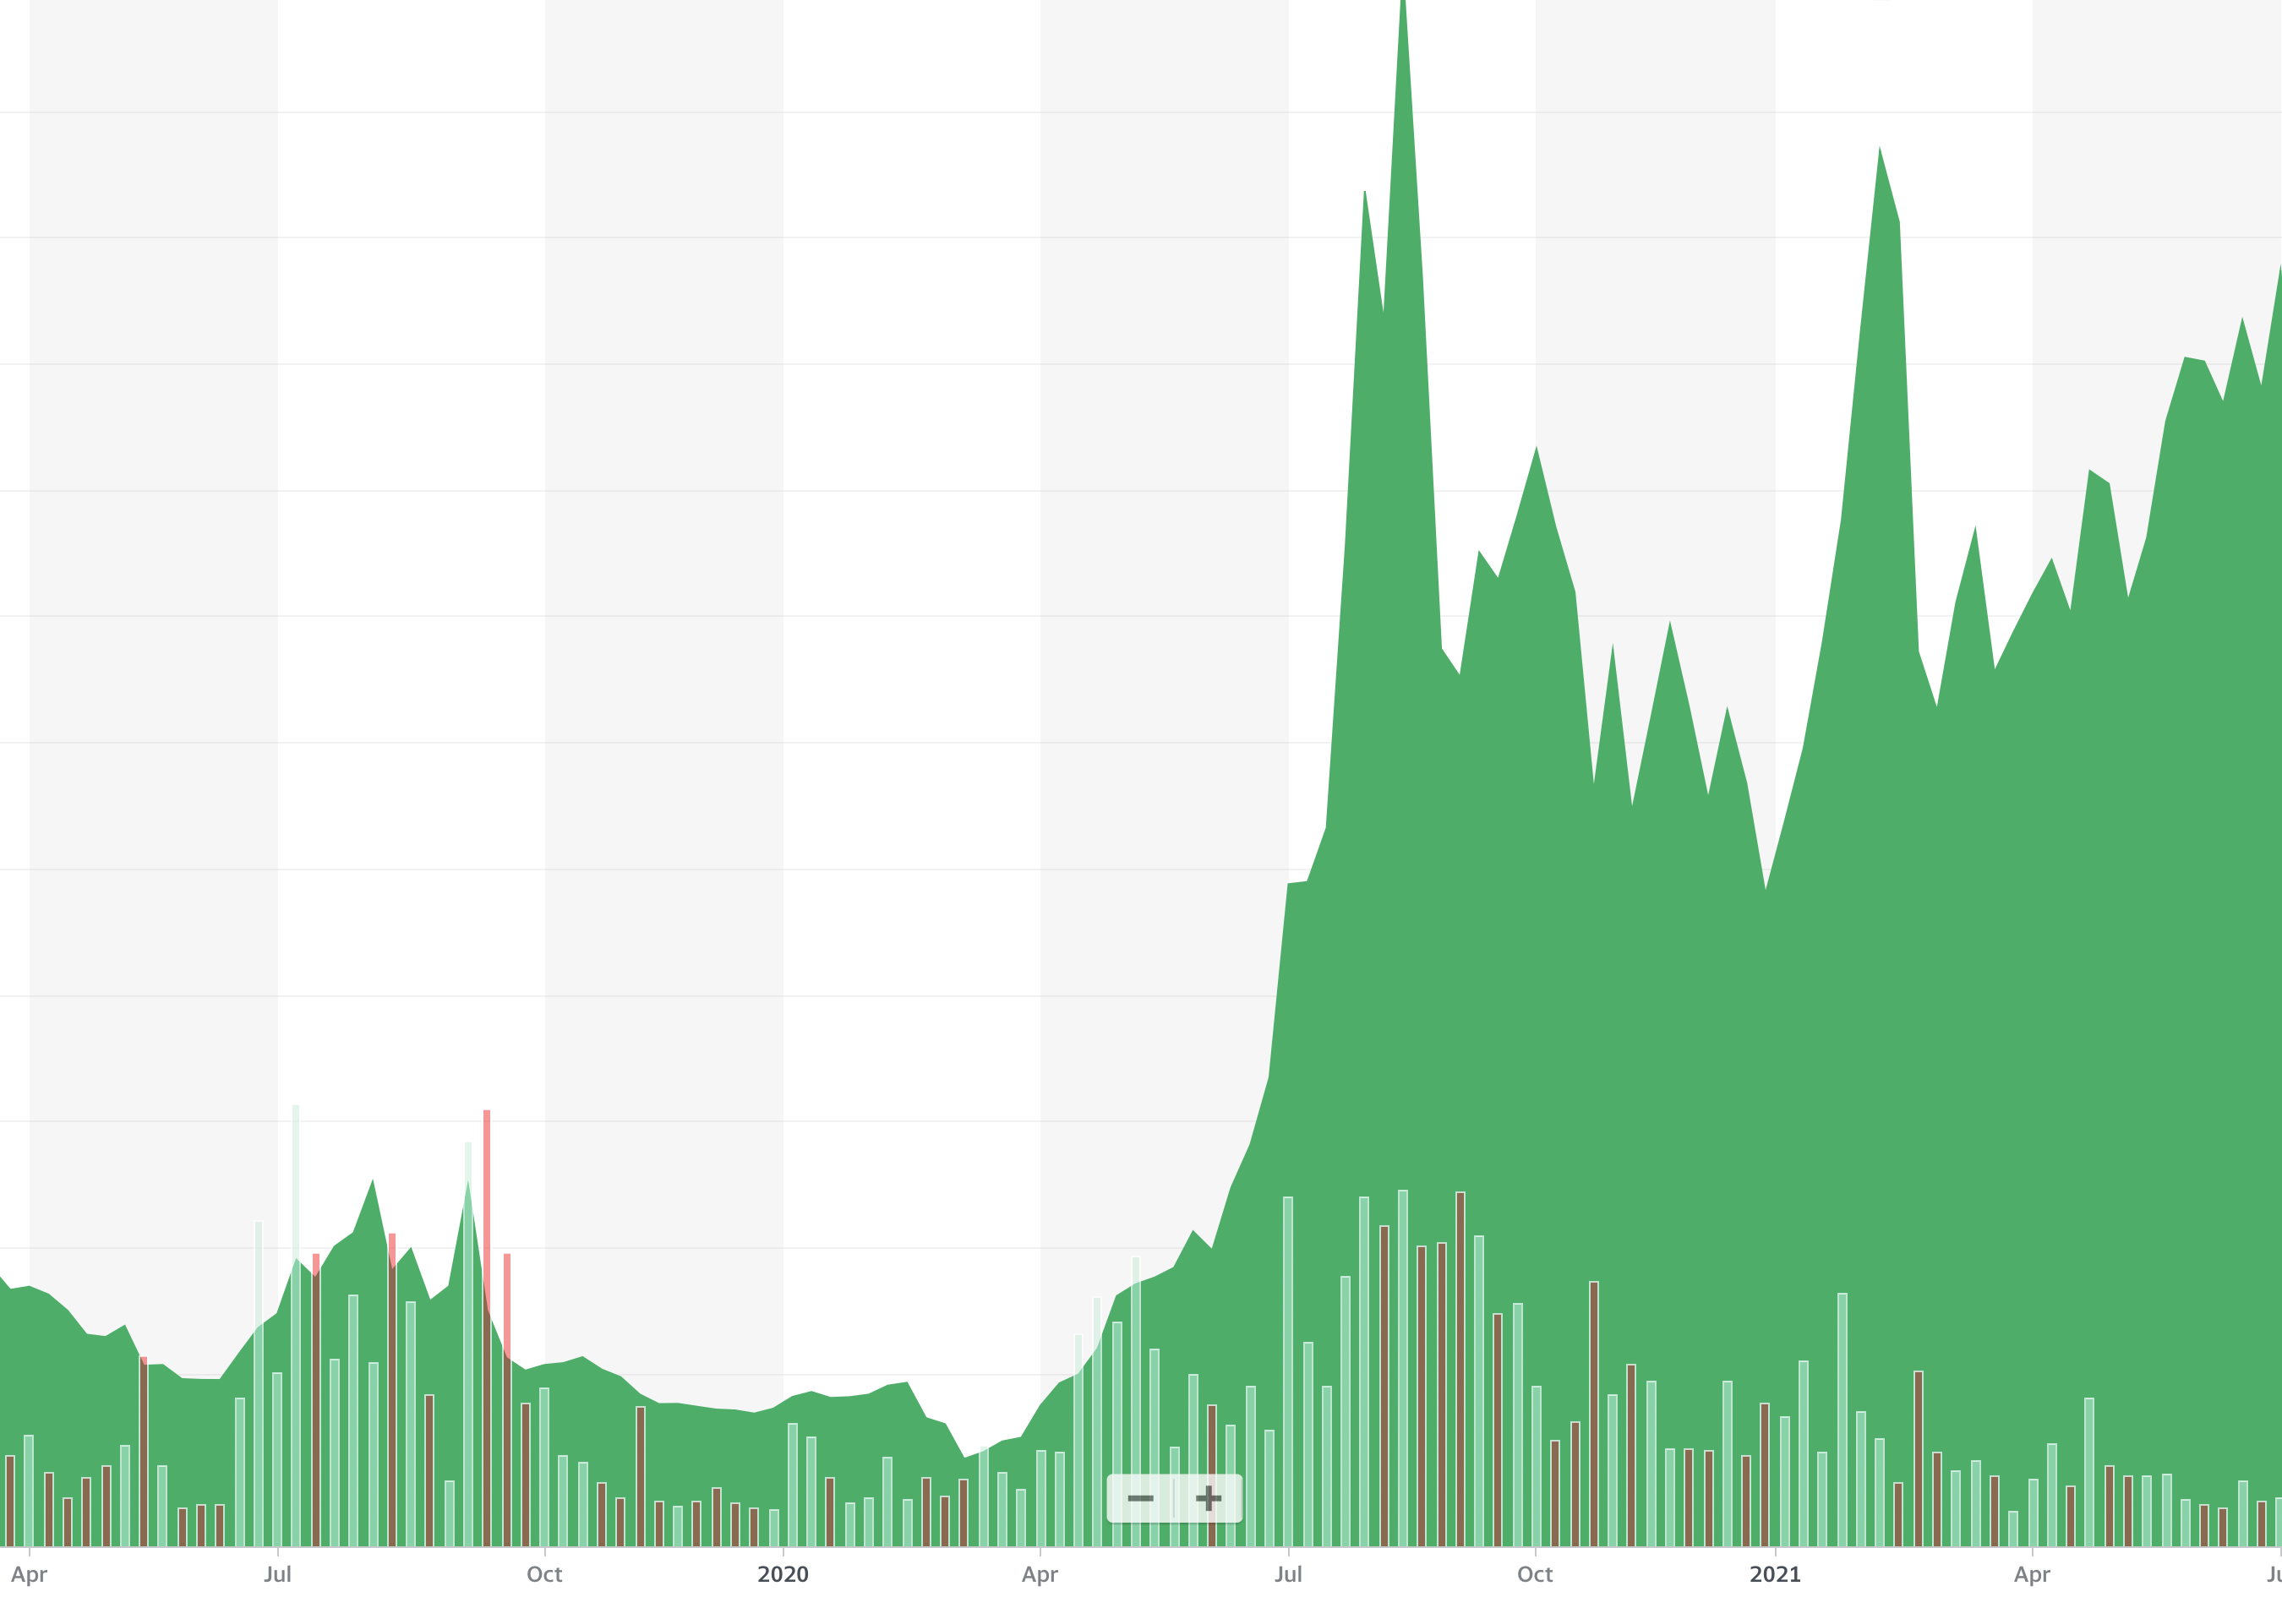

SATISFACTION
DISENGAGEMENT EVEN IMPACTS
CUSTOMER SATISFACTION
50
47
45
41
42
40
35
30
EMPLOYEE SATISFACTION (eNPS)
25
20
STOCK
PERFORMANCE
15
10
5
2
-7
Spring 2019
Fall 2019
Spring 2020
Fall 2020
Spring 2021
Notes:
Perhaps the most clear evidence of this is with an online retailer called Overstock.
They had abysmal employee satisfaction and then decided to really go all-in on solving for employee sentiment (satisfaction and engagement). And the result was a profound increase in employee satisfaction.
More importantly, when you overlay that to their stock performance, you can see an absolute and irrefutable correlation between employee sentiment and market sentiment!
Which begs the question… what could your organization be capable of if it did the same thing? If that’s you on the left now, performing as you are… if you were to totally go all in on solving for employee sentiment, what’s in store for you is the right side of this chart.

Slide 9
SOLUTION
SOLUTION
WHAT WE NEED IS A WAY TO MEASURE AND MANAGE
EMPLOYEE SATISFACTION AND ENGAGEMENT.
ACCURATE
EASY TO USE
ACTIONABLE
Grounded in Science
SaaS Solution
Insight and Instruction
Notes:
The problem, of course, is how do you measure an emotion.
What we need is a way to measure and manage employee satisfaction and engagement.
But with how important this is to organizational outcomes, it needs to be Accurate, Easy to Use, and Actionable.
By accurate it needs to be grounded in science. Not just pulled out of a hat.
By easy to use it needs to be SaaS, simple, easy-to-use online solutions.
By Actionable, it needs to also provide insight and instruction on what to do with your results.

Slide 10
SOLUTION
SOLUTION
A WAY TO MEASURE AND MANAGE
EMPLOYEE SATISFACTION AND ENGAGEMENT.
Put the force of work back into the workforce.
ACCURATE
EASY TO USE
ACTIONABLE
Grounded in Science
SaaS Solution
Insight and Instruction
20 years, millions in research
Expert science team
Top-tier management experts
Online surveys
Takes less than 10 min
Results anyone can read
Report-specific insights
Created by experts
Full online academy
Notes:
It’s grounded in science…
With 20 years and millions invested in research, with an expert science team working hand in hand with a team of top-tier management consultants to really understand the science and psychology of employee sentiment and how that connects to employee performance.
It’s easy to use… a simple set of online surveys. The longest survey on engagement, which really measures deep, still takes less than 10 min. And they produce results that anyone can read.
And more importantly, it’s actionable. As opposed to just a diagnostic that tells you what’s broken, and not how to fix it, these assessments produce report-specific insight that were created by our team of experts so you can know how to solve for the very problems you have.
And it all includes a full, online academy with hours and hours of rich content to drive personal development, leadership development, and organizational development.

Slide 11
ENGAGEMENT
PRICING
FOR EMPLOYEES
FOR LEADERS
$14.99 PEPM
$24.99 PLPM
$5,000 / 4-Hour Engagement
Per employee per month
per leader per month
ONLINE ACADEMY
ASSESSMENTS
LEADERSHIP ACCESS
SERVICES
Employee Wellness investment
Learn the elements that lead to peak engagement
Discover top performance frameworks
Personal Assessments
Work Assessments
Additional leadership content
Run team reports
Assessment based:
Training
Coaching
Consulting
Notes:
For employees it costs only $14.99 per employee per month, this is a personal development investment to power employee wellness. It gives them access to an entire online academy of incredible content, and assessments for them to measure engagement not just at work, but in all the other aspects of their lives.
For leaders it costs $24.99 per leader per month, giving them access to everything in the employee account, plus additional leadership development courses and content, and the ability to generate reports on their teams.
And for those who want it, there additional training packages, and assessment-based coaching and consulting that we make available for those times you get your results back and you want more highly-tailored help.

Slide 12
ENGAGEMENT
ENGAGEMENT ROI
AVERAGE SALARY
A DISENGAGED EMPLOYEE
IF YOU INVESTED IN
THAT MEANS
YOU’D BE SAVING
In the U.S. is about
costs 34% of their annual salary (Gallup)
Employee Engagement
$70,000 / year
$23,800 / year
For only about
over
That’s about
That’s about
$5,800 / Mo
$1,900 / Mo
$14.99 / Mo
$900 / Mo
per employee!
per employee!
per employee!
What if you could cut this cost in half?
And of course, maybe much more.
Not including what you’d make
by improving performance.
Not including the impact that would have on customers.
Notes:
One way to look at the ROI of this is that in the US, the average salary is $70k / year… that’s about $5,800 per month.
According to Gallup’s latest research, a disengaged employee ends up costing the organization (all told) about 34% of their annual salary. Against that average salary, that equates to about $1,900 per employee per month.
By comparison, if you invested in an employee satisfaction and engagement solution… it would cost you only about $14.99 per month…
What if that investment was able to cut disengagement by half? That would mean the cost of disengagement would go down to about $900 / month.
Would you spend $14.99 a month to save $900 per employee per month?
And that doesn’t include the additional outcomes of all the increased performance… nor the outcomes that engagement would have on customers!

Slide 13
NEXT STEPS
WHAT’S NEXT
LIVE DEMO
TAKE YOUR OWN ASSESSMENT AT
www.LifeEngineering.com/engage
Notes:
We’d love to actually get you into the product to show you what it looks like and give you a live demo. We can either do that right now, or if you’d like, we can set up another time with Life Engineering’s Founder and CEO.
And after this, you can take your own assessment by visiting LifeEngineering.com/engage. You’ll be able to see what those results look like, and imagine having that level of detail across all the employees in your organization.

Slide 14
APPENDIX
APPENDIX
Notes:
We’d love to actually get you into the product to show you what it looks like and give you a live demo. We can either do that right now, or if you’d like, we can set up another time with Life Engineering’s Founder and CEO.
And after this, you can take your own assessment by visiting LifeEngineering.com/engage. You’ll be able to see what those results look like, and imagine having that level of detail across all the employees in your organization.

Slide 15
SCIENCE
SCIENCE TEAM
Outside of external validation resources, these constitute the core contributors of our science foundation
Cory Reich
Bachelors in Family and Human Development
Masters in Marriage and Family Therapy
Doctorate in Child Studies and Human Development
Co-founder, Phoenix Recovery Center
Cofounder, Institute for Addiction Study
Authored two books on addiction
30 yrs in addiction, mental health, life & corporate coaching
Kristin Elinkowski
Masters of Applied Positive Psychology, University of Pennsylvania
BA, Political Science, Weber State
Business Broker, Alpine Business Brokers
President, Blazing Innovations
Chairman, Utah State Charter School Board
Charter School Representative, Utah State School Board
Chief Science Officer
Sr. Research Scientist
Stacy Taniguchi
Climbed 6 of the highest summits in the world
International keynote speaker
Professor, Experience Design and Management from Brigham Young University’s Marriott School of Business
Ph.D. from BYU in the science of experiential education
Owner and chief guide of Kahiltna Visions, international expedition leadership training.
10 years, designing programs for corporate leaders and EMBA/MBA students
Craig Case
Partner, Ampelis Consulting
Author, Founder, Inspired Solutions Publishing
Co-Founder, Direct Selling Institute
Co-Founder, One Thing Group
President, Max International
VP Sales, Franklin Covey
SVP, Science
Director, Applied Science
Notes:
We’d love to actually get you into the product to show you what it looks like and give you a live demo. We can either do that right now, or if you’d like, we can set up another time with Life Engineering’s Founder and CEO.
And after this, you can take your own assessment by visiting LifeEngineering.com/engage. You’ll be able to see what those results look like, and imagine having that level of detail across all the employees in your organization.

Slide 16
CONSULTANTS
MANAGEMENT CONSULTANTS
These individuals constitute the core contributors to our intellectual property, frameworks, and instructional content
Richard Godfrey
Ralph Harding
Niel Nickolaisen
Co-founder, Ampelis Leadership Development
Founder, CEO 3Gaps personal, and leadership development
Founder The Galileo Initiative, a business consultancy
Senior international consultant / SME, Franklin Covey (16 yrs)
Leadership development curriculum (Cisco Systems, Mercedes Benz, US Marine Corps, and many others)
12 books on org, leadership and personal development
Degrees in general, behavioral, cognitive, org. psych
Internationally recognized author, speaker, executive coach and consultant
40 years serving as CEO, CFO, COO, and Chief Business Development Officer
Member of multiple Boards of Directors and Advisory Boards
Spans disciplines of:
  Fiduciary and operational governance
  Leadership and management
  Product quality and delivery
  Business development, marketing and sales
  Operations infrastructure and support
  Information Technology
  Human Resources, Finance and Accounting
CIO Franklin Covey
CIO Deseret Book
CIO WGU (Western Governors University)
CIO OC Tanner
Keynote Speaker
Published Author
Ryan Flint
Jared Harding
Treion Muller
Formerly President of Colliers
Business consultant, mentor
Keynote speaker
Industry-leading expert at customer service and loyalty, and building high-growth, high-impact company and customer cultures
Has conducted and overseen billions of dollars in transactions, while maintaining deep, long-standing relationships with enterprise clients
VP, Facilitation and Coaching, Zenger Folkman, 7 Yrs
BA English Rhetoric, Utah State
MA Management and Leadership, Western Governors University
Certified Executive Coach
Certified Master Facilitator
Certified Qualitative Research Methods
Chief Product Officer, Korn Ferry
Chief Product Officer, Strategy Execution
Chief Product Officer, TwentyEighty
Chief eLearning Architect, Franklin Covey
MA in Instructional Design
BA Communications & Management

Slide 17
CONSULTANTS
MANAGEMENT CONSULTANTS
These individuals constitute the core contributors to our intellectual property, frameworks, and instructional content
Sabrina Petersen
Jon Rowberry
Nate Thompson
Senior Director of Global Content Operations Ancestry.com
Marketing and PR Executive at Gannett
MBA from BYU Marriott School of Business
CFO then CEO Franklin Covey
CEO Galileo Initiative
CFO Adecco
Partner, Deloitte & Touche
Principle Consultant, RBL Group, 13 years
MBA, BYU
Chris Low
Carl Sokia
Rusty Lindquist
20 years enterprise SaaS product management
Executive Vice President of Product Management for one of the largest real estate technology companies in the U.S.
International experience managing global development operations and offshore teams in India, Armenia, Japan, China and Western Europe
MBA from the Marriott School of Business at Brigham Young University, with an emphasis in business strategy
Consultant and Keynote Speaker
Founder, Managing Partner, Ohana Experience
Founder, CEO Experience Management Solutions
Chief Human Experience Officer, LE
Executive Director, People Operations, Grand America
Director of HR Grand Wailea, Waldorf Astoria
Director of HR, St. Regis
Corporate Recruitment & Employment Manager
20 years running product departments in major organizations, including Instructure (makers of Canvas LMS)
Successfully built and brought to market 12 major SaaS products, with millions of users
Invented & designed #1 app in Apple Business category for over 6 months
Ran market strategy for 4 major SaaS organizations
Ran UI/UX at Franklin Covey
Keynote speaker (over 50 speeches delivered)

